Slide 1
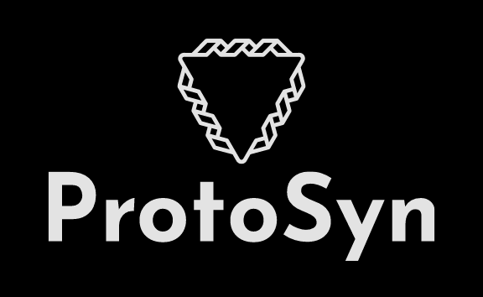
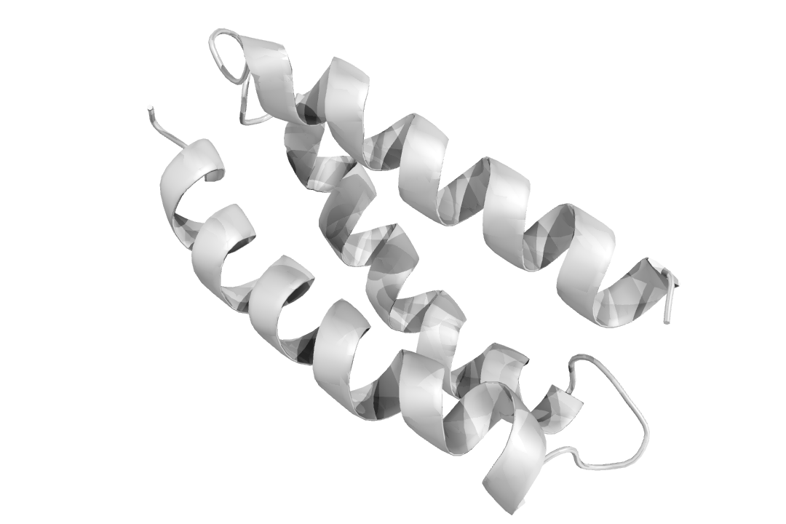
Computational design of peptides
Laboratório de Visualização e Computação Científica
Module 2
José M. S. Pereira
2020-2021
jose.manuel.pereira@ua.pt

Slide 2

Program
Intro
Practical examples
Challenge
30 min
60 min
90 min
Break

Slide 3
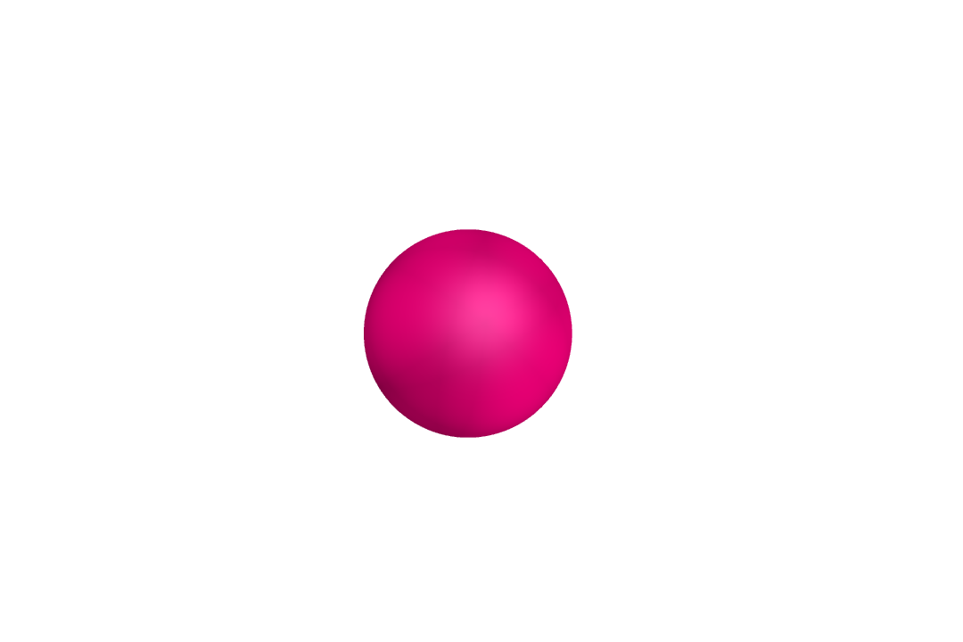
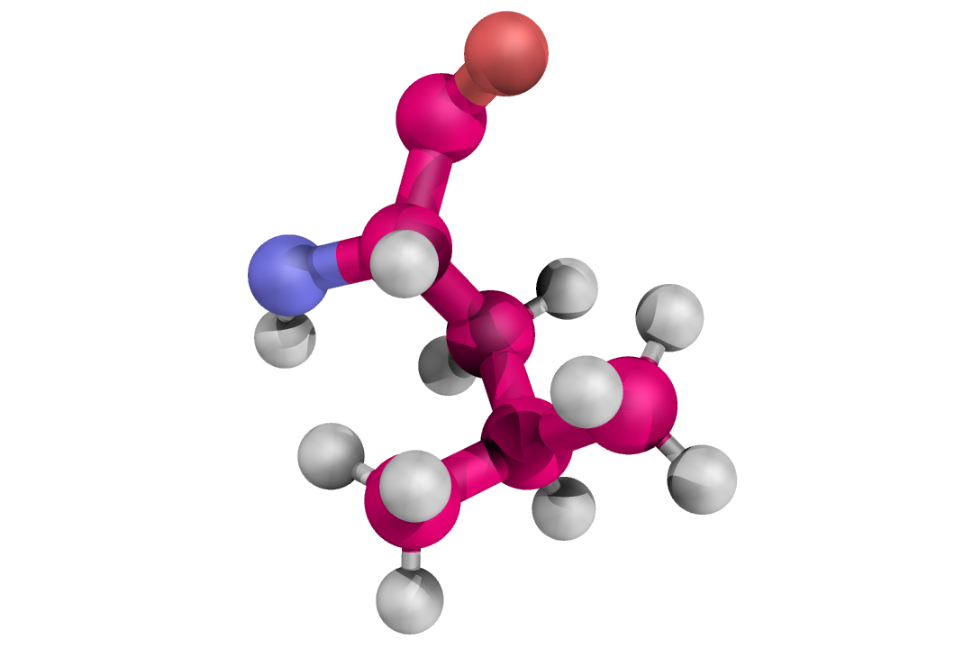
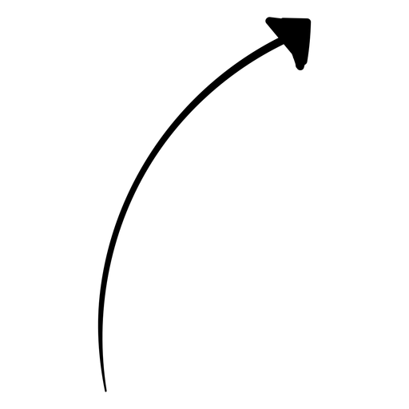
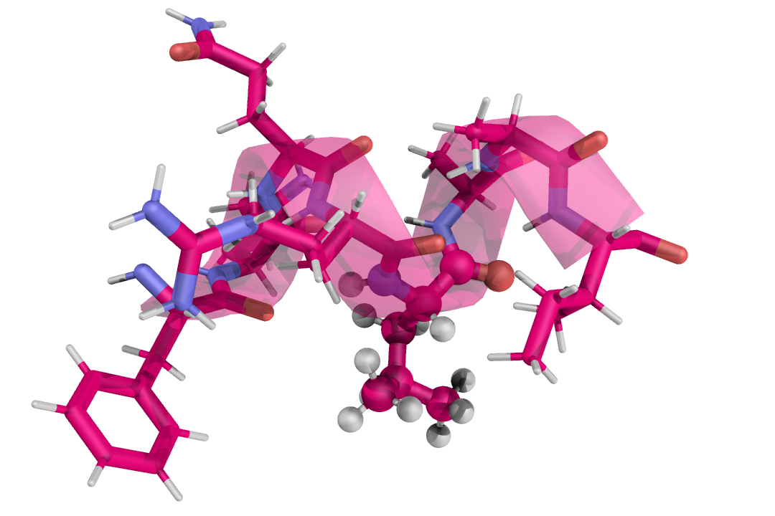
What’s a peptide?
A group of aminoacids is called a protein.
A small protein (around 100 aminoacids) is called a peptide!
This is an atom
(trust me)
A group of atoms is a molecule.
This one in specific is called an aminoacid.

Slide 4
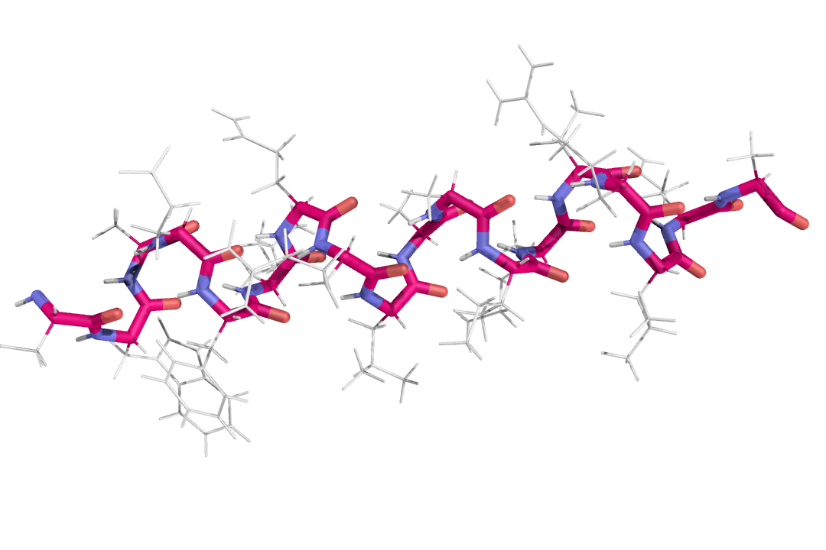
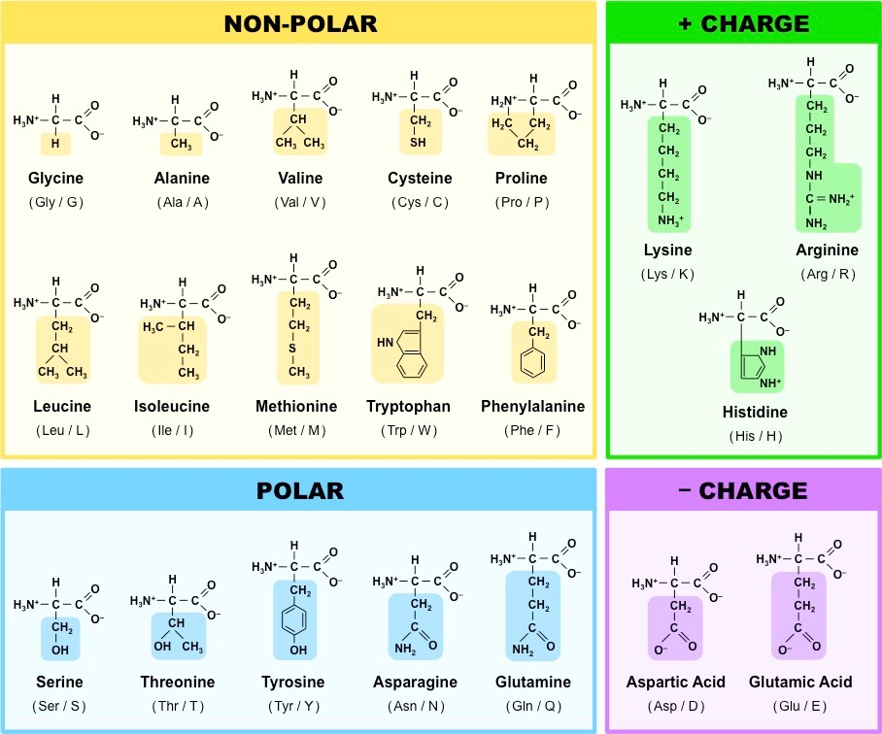
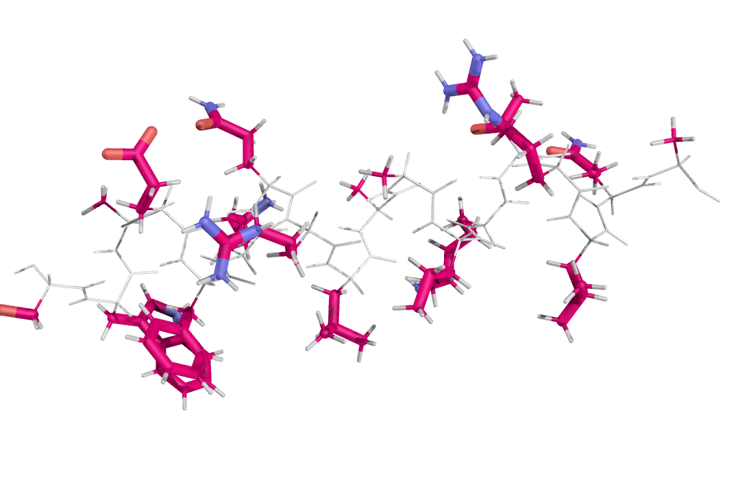
What’s a peptide?
All aminoacids have the same backbone
but have different sidechains.
There are 20 different aminoacids, each identified by a different letter.

Slide 5
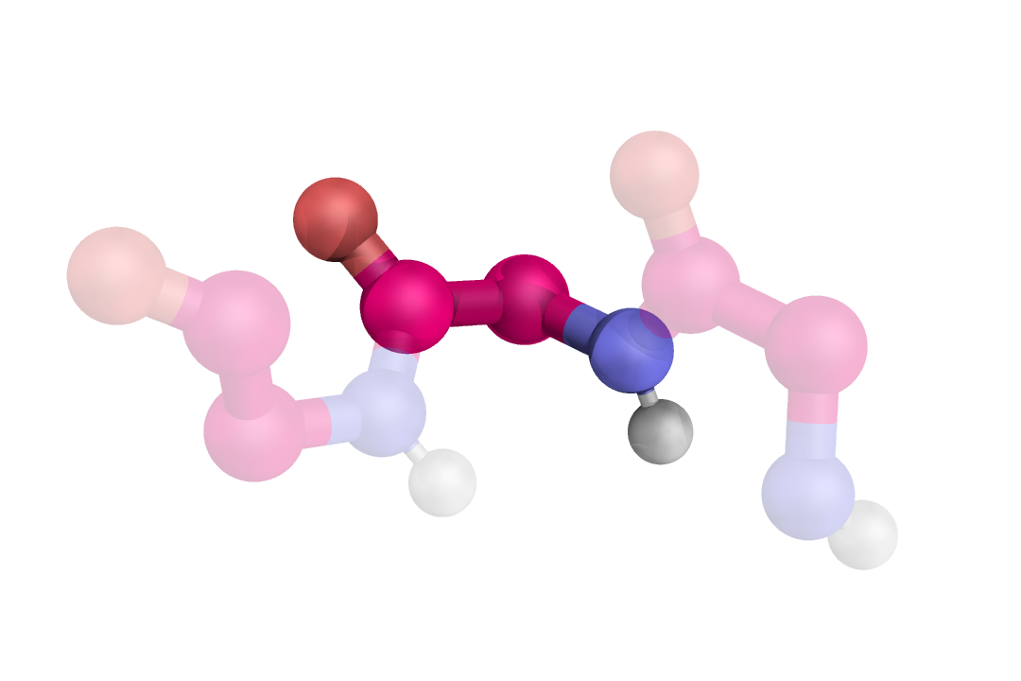
What’s a peptide?
A backbone has 5 atoms.
Oxigénio
O
Azoto
Cα
C
N
Carbono
H
Hidrogénio

Slide 6
What’s a peptide?
Sidechain attaches here!
A backbone has 5 atoms.
O
Cα
C
N
H

Slide 7
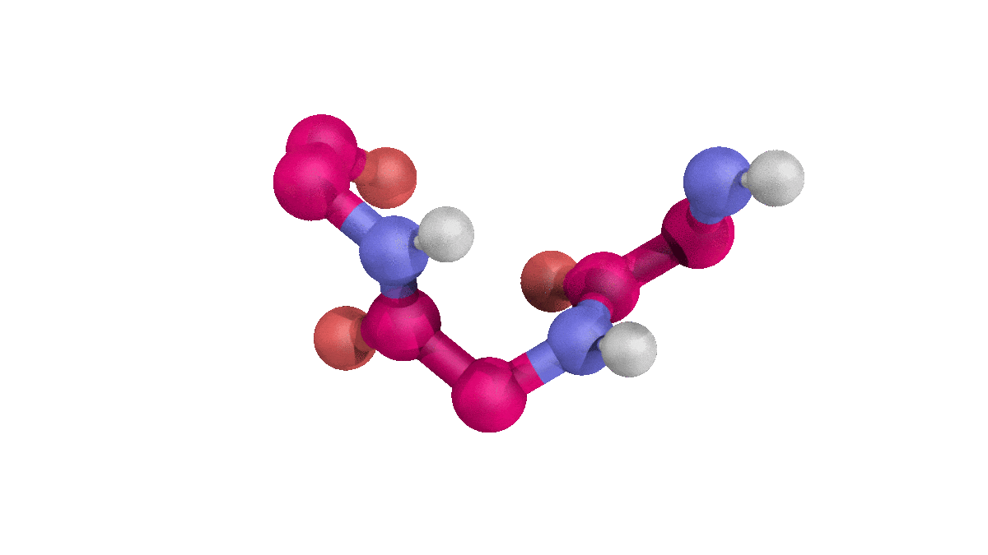
What’s a peptide?
A backbone has 5 atoms.
Bonds connect two atoms and can be rotated.

Slide 8
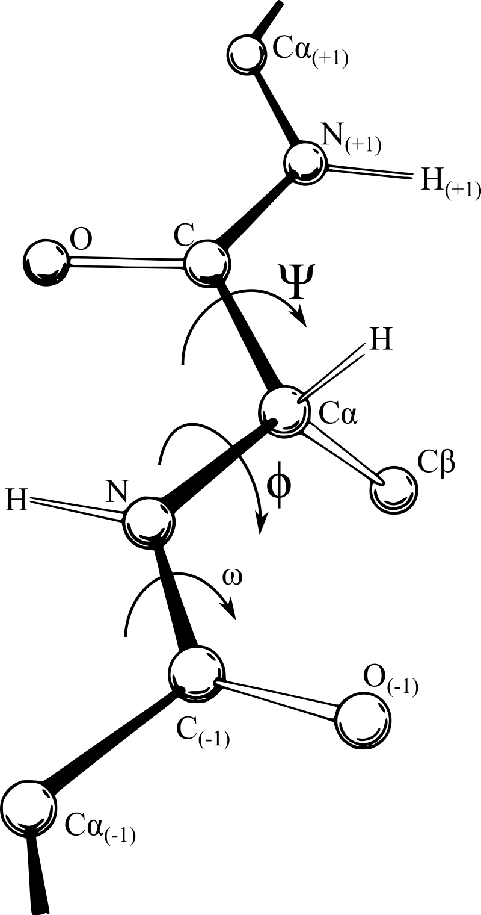
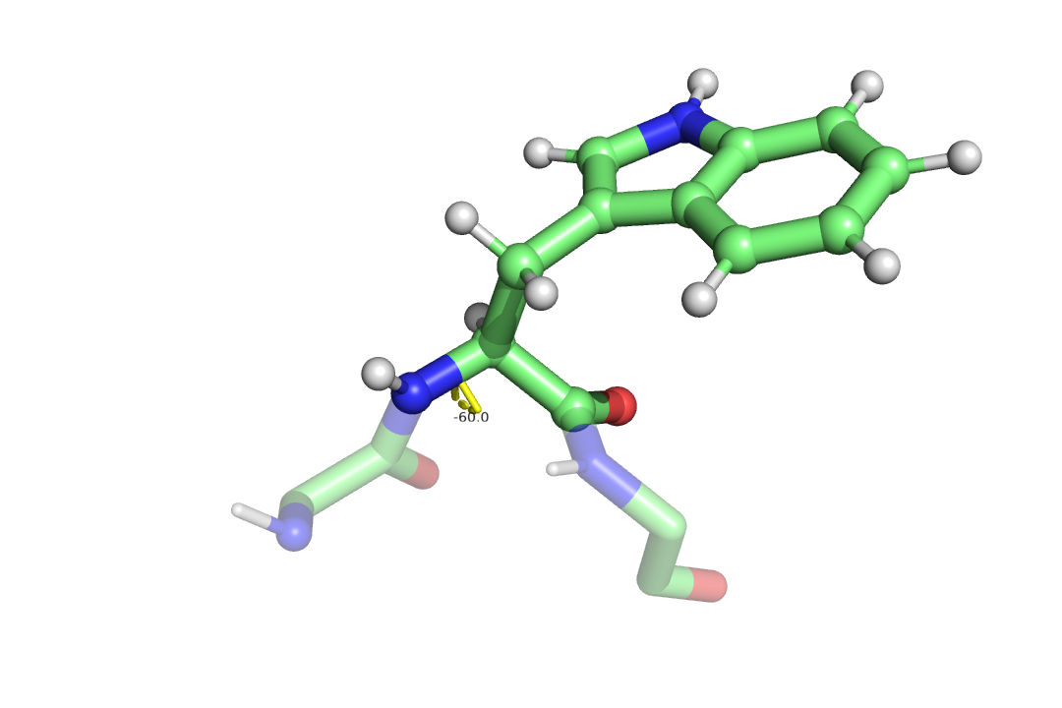
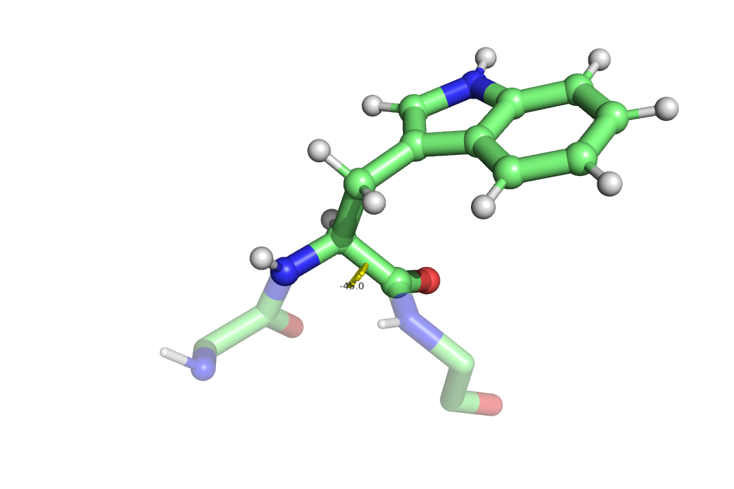
What’s a peptide?
A dihedral angle is the angle between two planes.
Psi
Phi
Phi = -60º
Psi = -45º
Omega

Slide 9
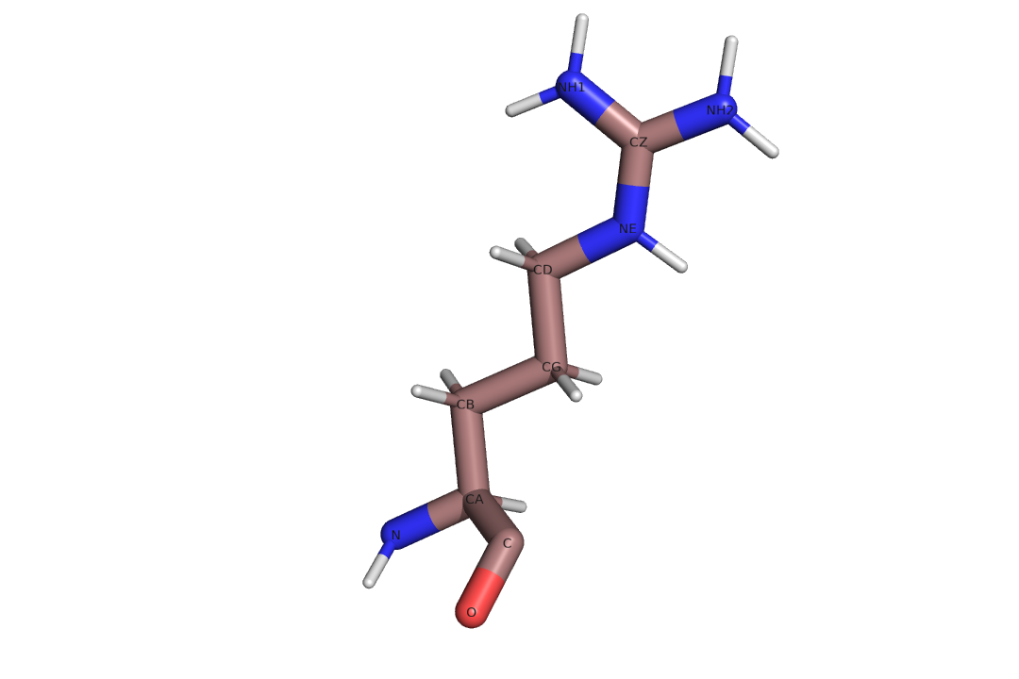

What’s a peptide?
A dihedral angle is the angle between two planes.
Chi 4
Chi 2
Chi 3
Chi 1

Slide 10
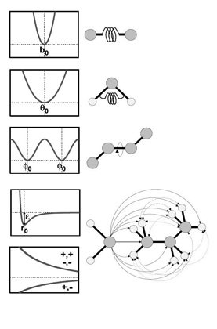
What’s a peptide?
Atoms interact with the environment (hydrophobic effect, water molecules packaging, etc).
This is known as entropy.
ΔG = ΔHsystem—TΔSsystem
Atoms interact with each other in many ways and impose certain positions/rotations.
This phenomenon is known as enthalpy.

Slide 11
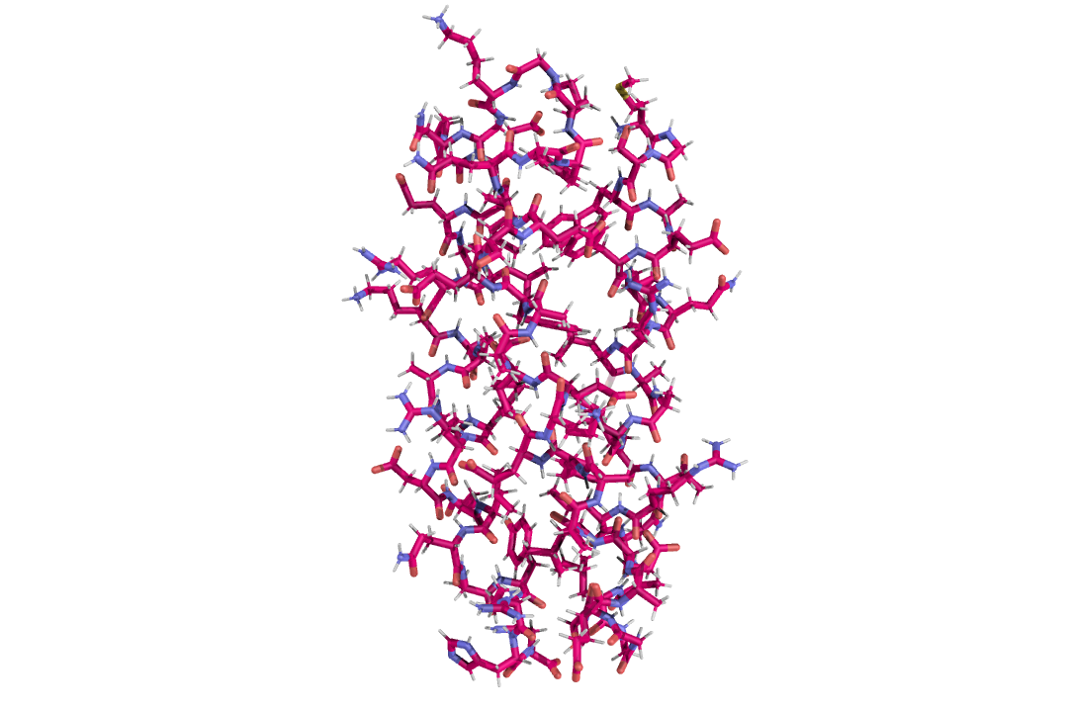
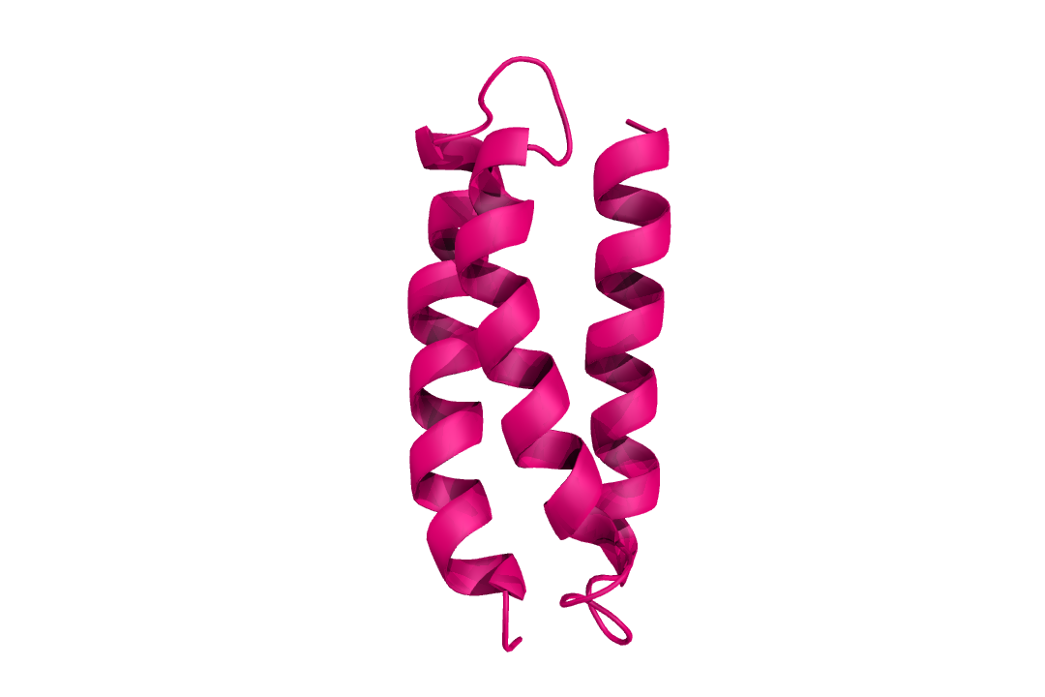
What’s a peptide?
Atoms interact with each other and the environment in many ways and impose certain positions/rotations.
Naturally, this effects causes the emergence of secondary structures, such as the alpha helix.

Slide 12
Ok …
The peptide structure therefore is a
physical expression of the sequence of aminoacids
that compose the peptide.
MGSWAEFKQRLA …

Slide 13
Why design peptides?
Proteins and peptides are the machines of our cells.
Structural
Messenger
Enzimes

Slide 14
Why design peptides?
Proteins and peptides are the machines of our cells.
Antibodies
Transport

Slide 15
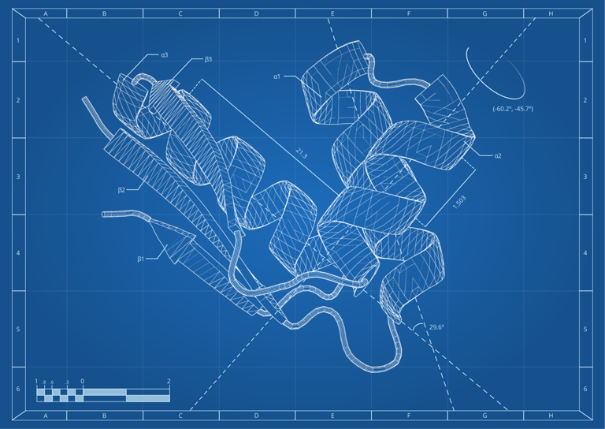
Why design peptides?
Designing a peptide means trading, removing or adding one or more aminoacids of a peptide to obtain a new structure.
Structure
=
Function

Slide 16
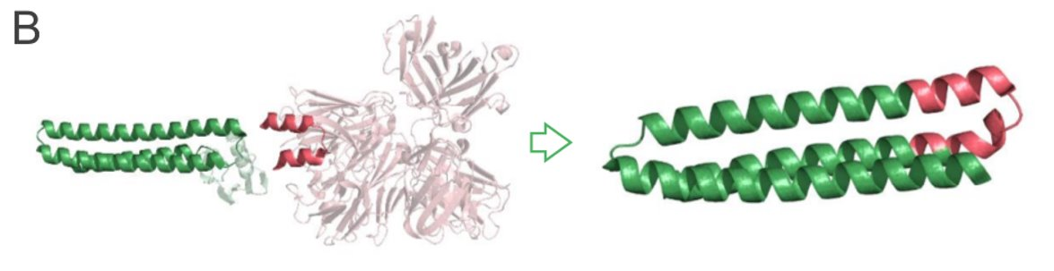
Why design peptides?
Some examples:
Possible new vaccine protein
Protein that does nothing
Part of HIV virus
Correia et al. (2010, 2014)

Slide 17
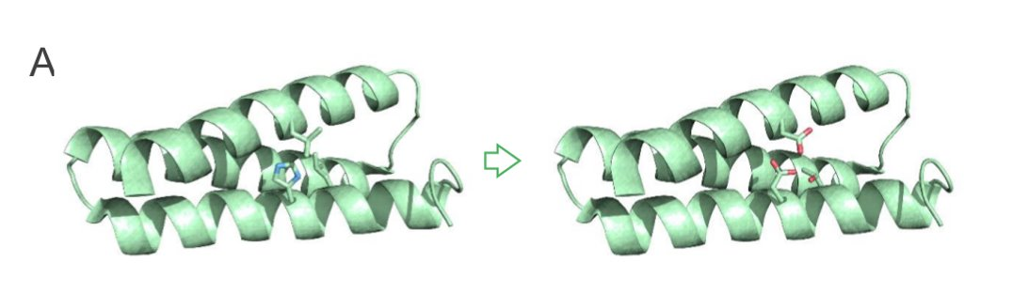
Why design peptides?
Some examples:
New protein was mutated and is now able to grab uranium from sea water
Old protein
Zhou at al. (2014)

Slide 18
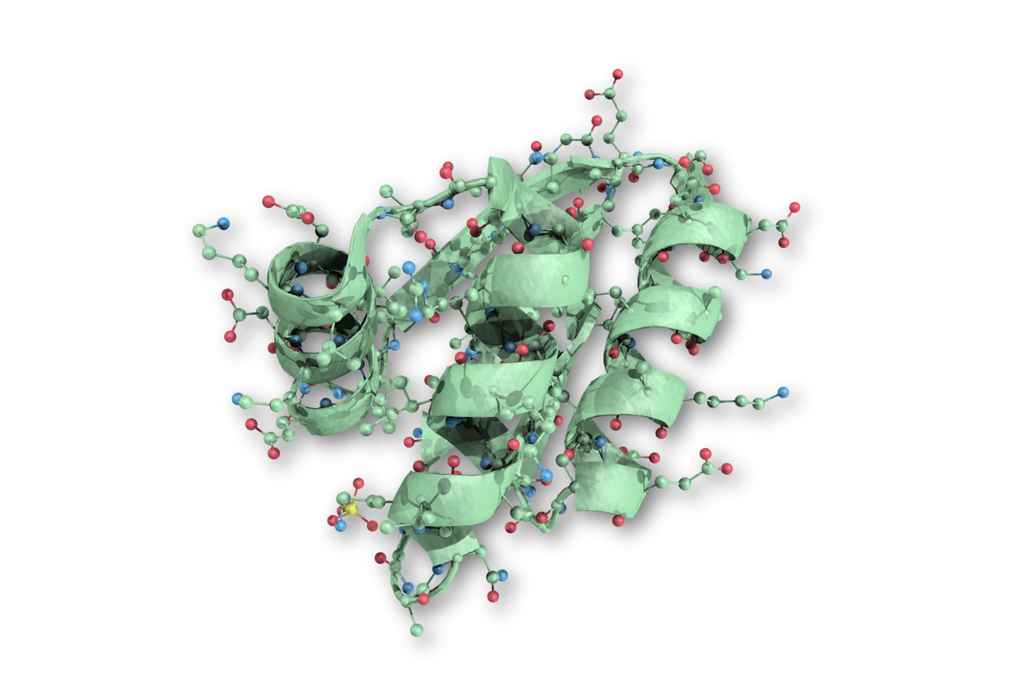
That makes sense …
Protein design unlocks the potential of proteins not yet explored by nature.

Slide 19
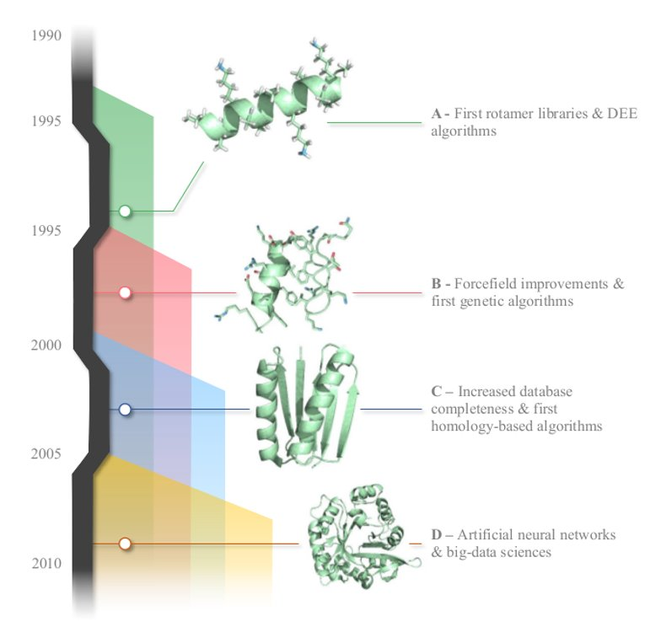
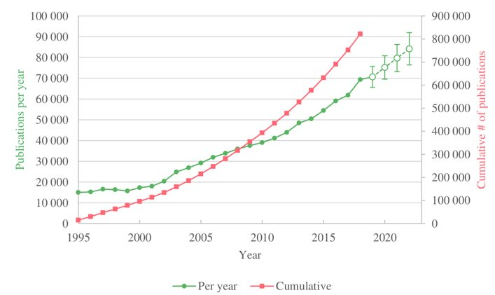
How?
Traditionally done by blind mutations in a lab.
Computational tools save time and money.
When searching ScienceDirect for “Protein Design”

Slide 20
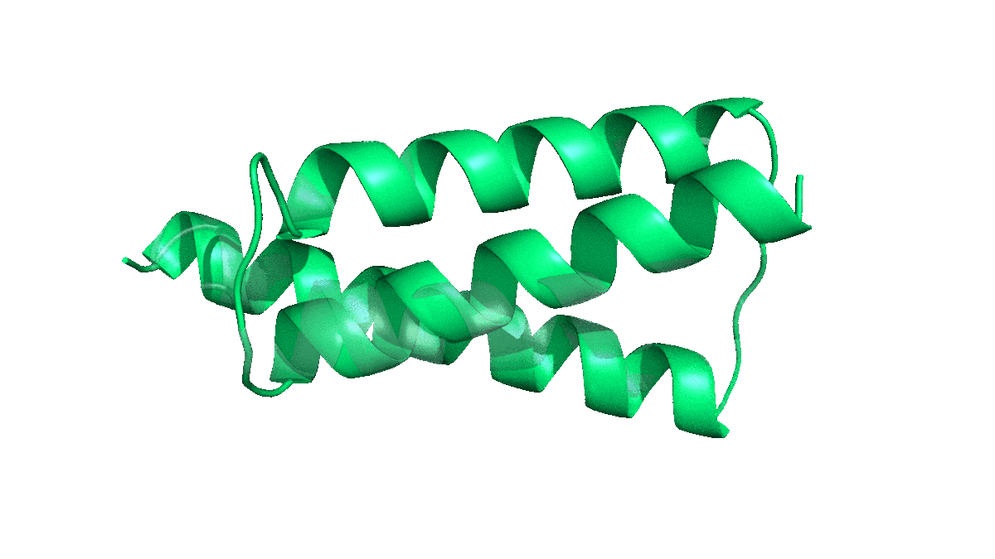
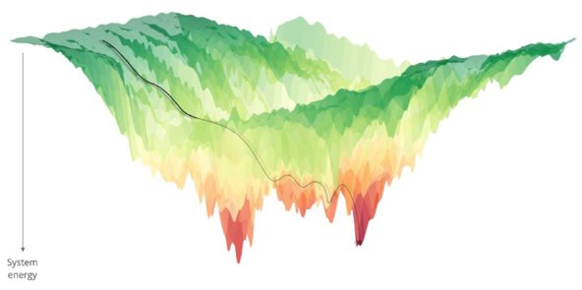
How?
Conformational search engine
Energy function
+
Changes the structure (and sometimes sequence) of a peptide
Evaluates the energy (or fitness) of a given structure

Slide 21
How?
Conformational search engine
Energy function
+
Monte-Carlo
Steepest Descent
Molecular Dynamics
Forcefields
Density Functional Theory (DFT)
Machine Learning and AI

Slide 22
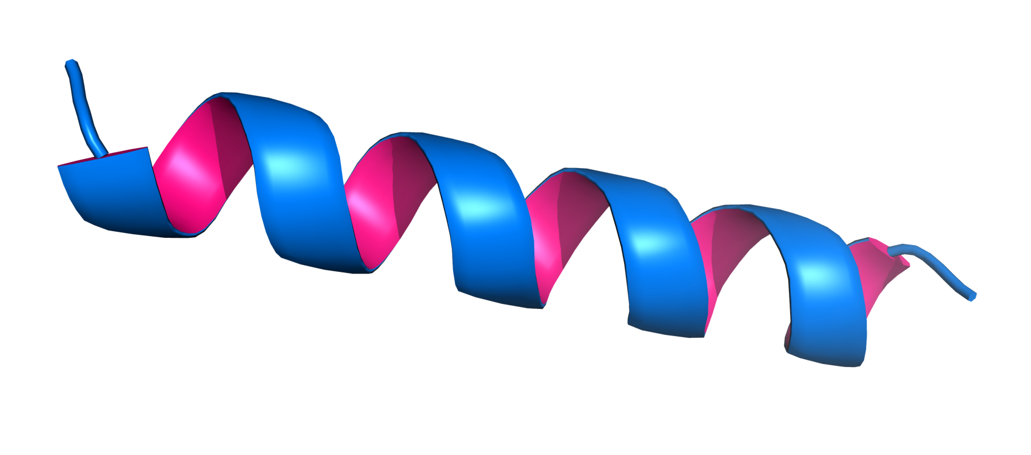
Alright, I get it now.
Computational manipulation of proteins requires a conformational search engine that exhaustively samples the conformational space in search for the structure that mimics reality with the highest possible affinity (highest energy function score).

Slide 23
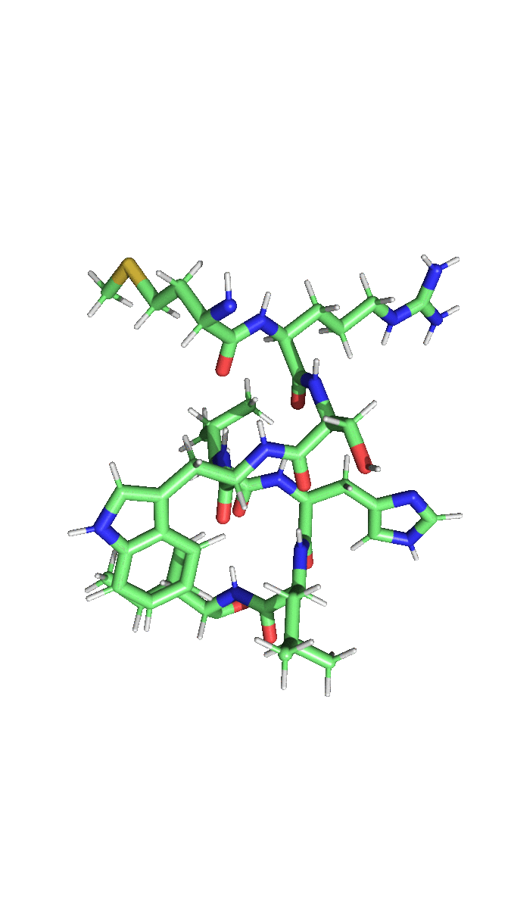
The challenge
A sub-problem of computational design of proteins is the correct placement of sidechains.
It is the sidechain interaction with each other and the environment that mostly provides the functionality to proteins (for example, enzymatic or catalytic activity).
Each sidechain can have multiple conformations (called rotamers). Which is the correct combination of rotamers of all sidechains that stabilizes the structure?

Slide 24
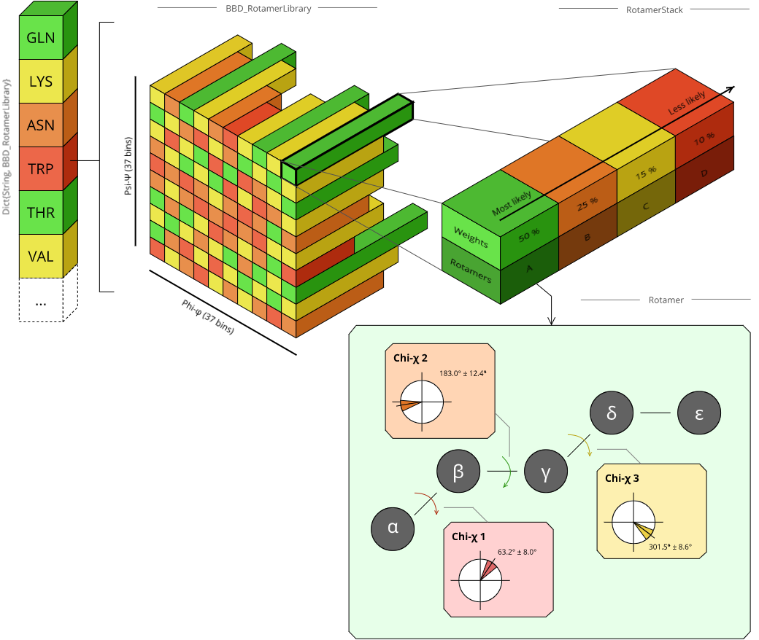
The challenge
The backbone angles greatly influence what rotamers are possible. This restrictions have been compiled in Rotamer Libraries.
Phi = -60º
Psi = -45º

Slide 25
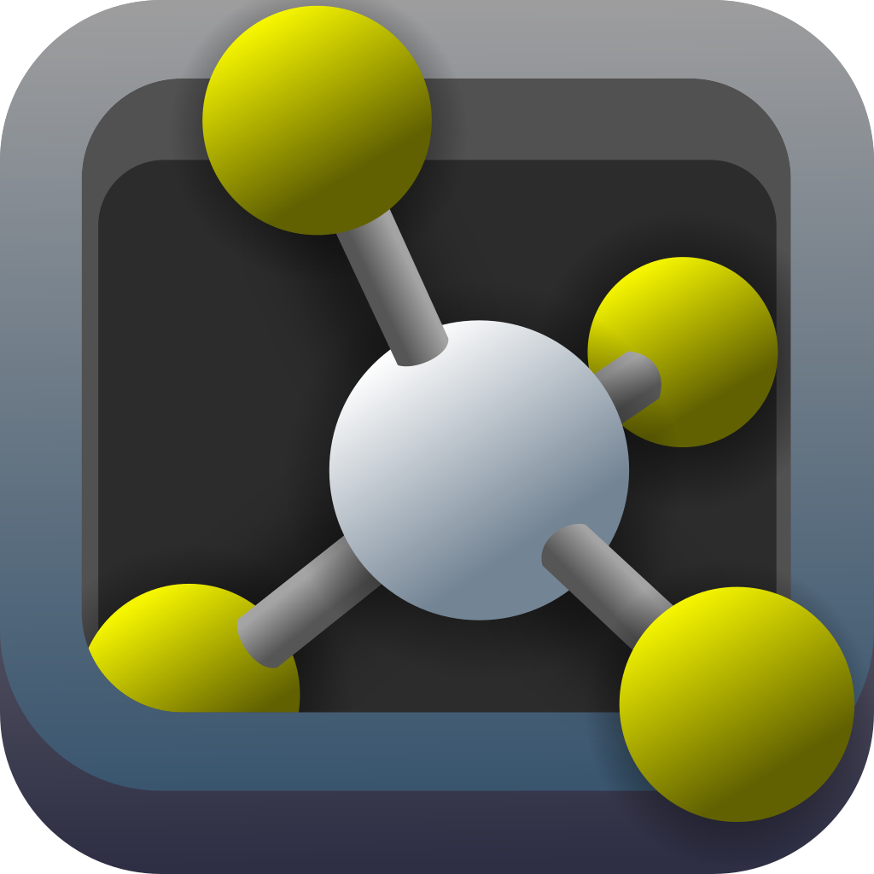
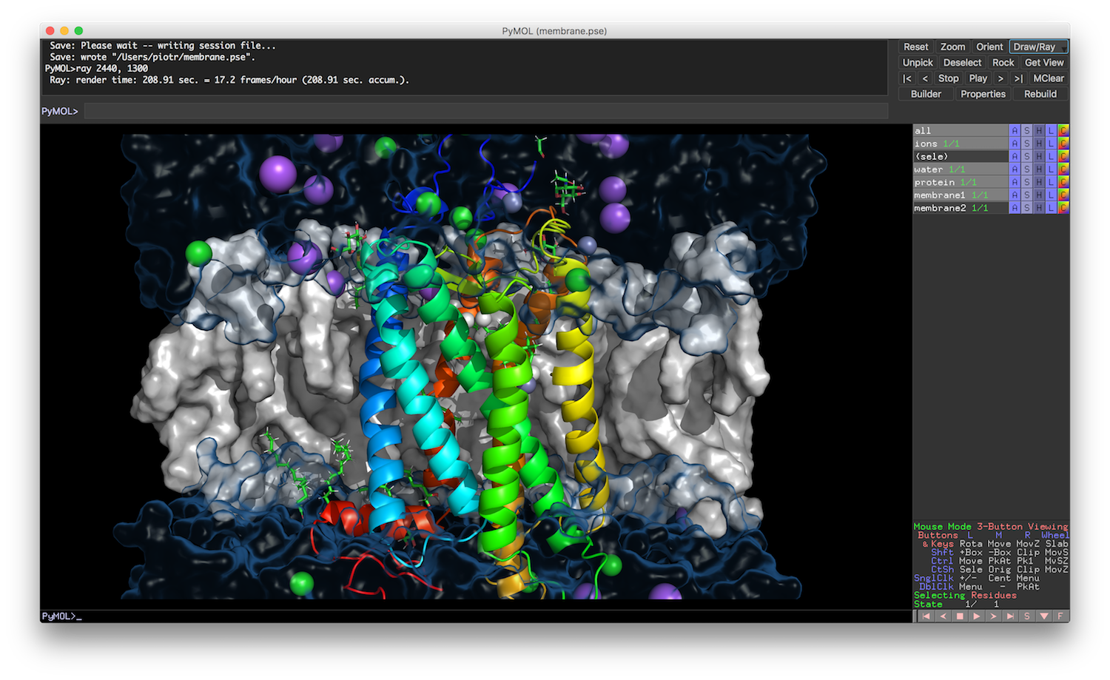
The challenge
Part of the process includes visualizing, measuring and confirming the predicted/designed molecular structures.
Several software solutions have been developed for visualization of molecular systems (VMD, Chimera, QuteMol, etc.)
For this module we will be using PyMOL.

Slide 26
The challenge
A small Python script has been provided as a starting point for this module’s work.
The molecular structure is represented by a directed graph.
7
10
Atom 1 is the parent of atom 3.
3
6
9
13
1
4
8
11
14
2
5
12
15

Slide 27
The challenge
A small Python script has been provided as a starting point for this module’s work.
An atom’s position can be given by 3 cartesian coordinates (X, Y and Z).
(3, 2, 0)
(…)
7
10
(1, 1, 0)
(3, 1, 0)
(…)
(…)
3
6
9
13
(0, 0, 0)
(2, 0, 0)
(…)
(…)
(…)
1
4
8
11
14
(0, -1, 0)
(2, -1, 0)
(…)
(…)
2
5
12
15

Slide 28
The challenge
A small Python script has been provided as a starting point for this module’s work.
Or by it’s internal coordinates, stating the distance, angle and dihedral change from the ascendents atoms.
7
10
grand-parent
3
dihedral
6
9
13
grand-grand-parent
parent
1
4
8
11
14
angle
distance
2
5
12
15

Slide 29
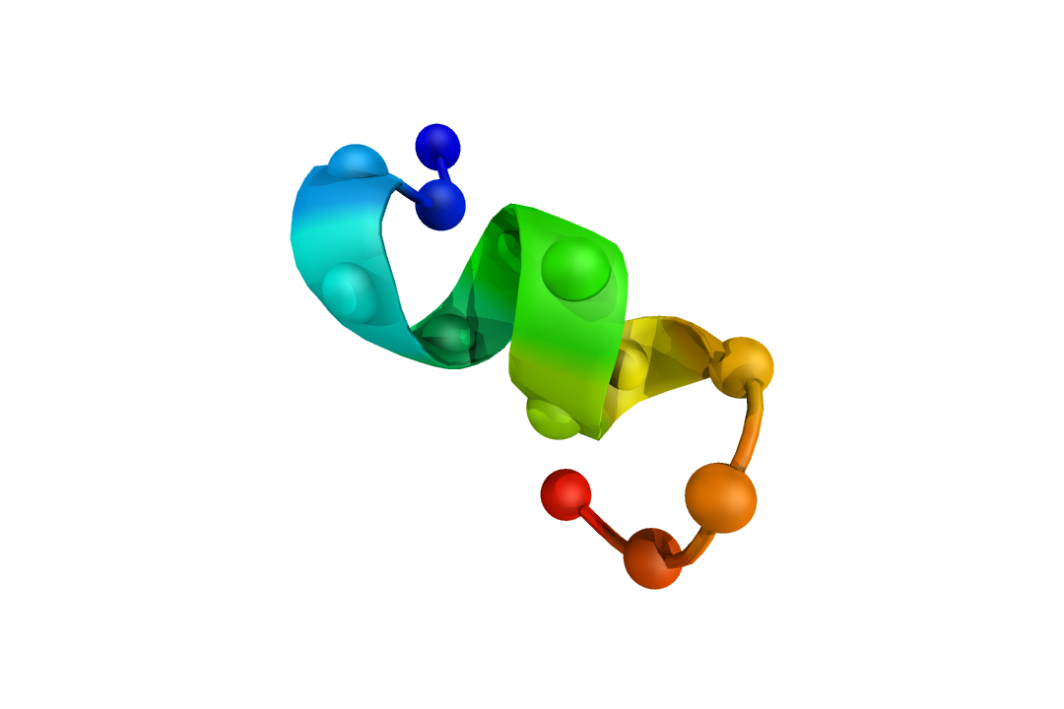
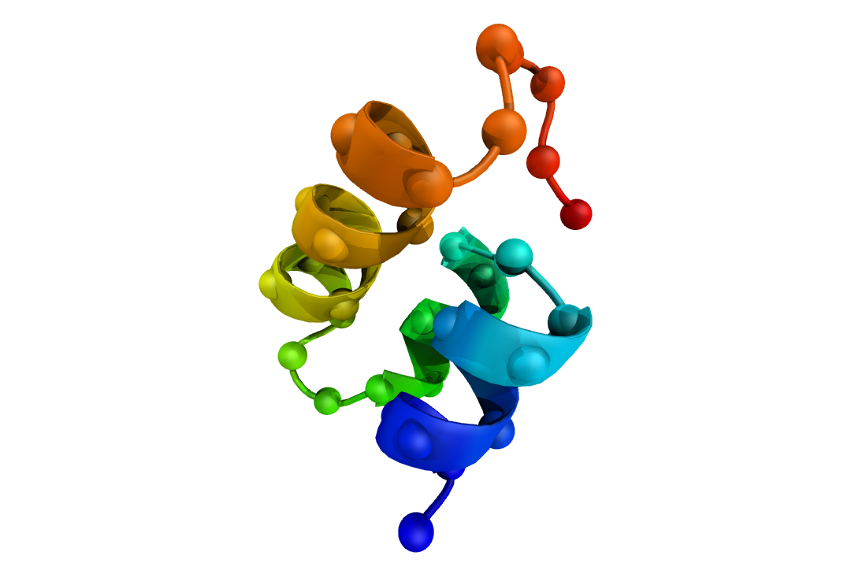
Some practical examples
Visualize a peptide on PyMOL
Rotate a dihedral
Measure a dihedral

Slide 30
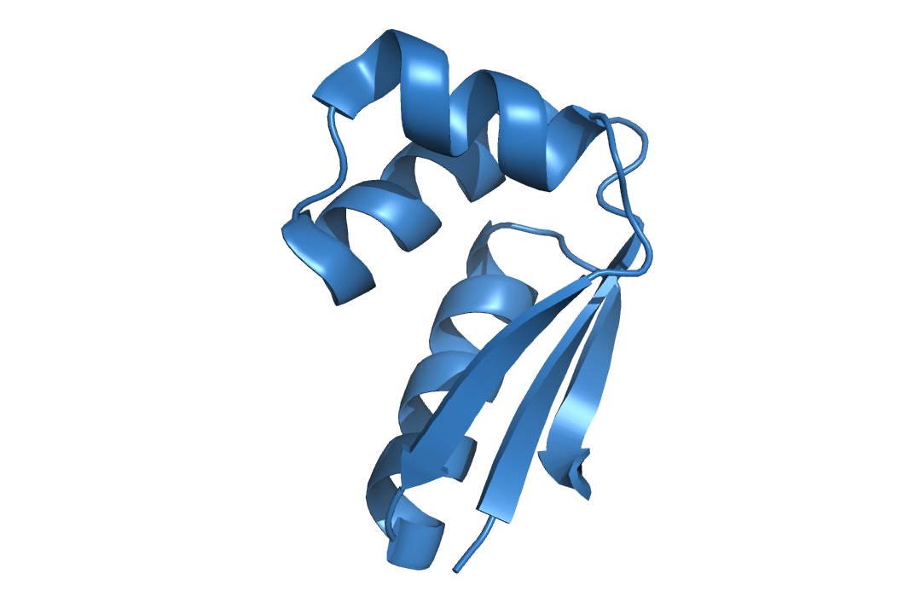
The challenge
Load a rotamer library
Apply a rotamer to a molecular structure

